Slide 1
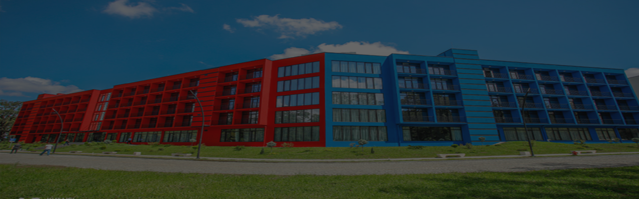
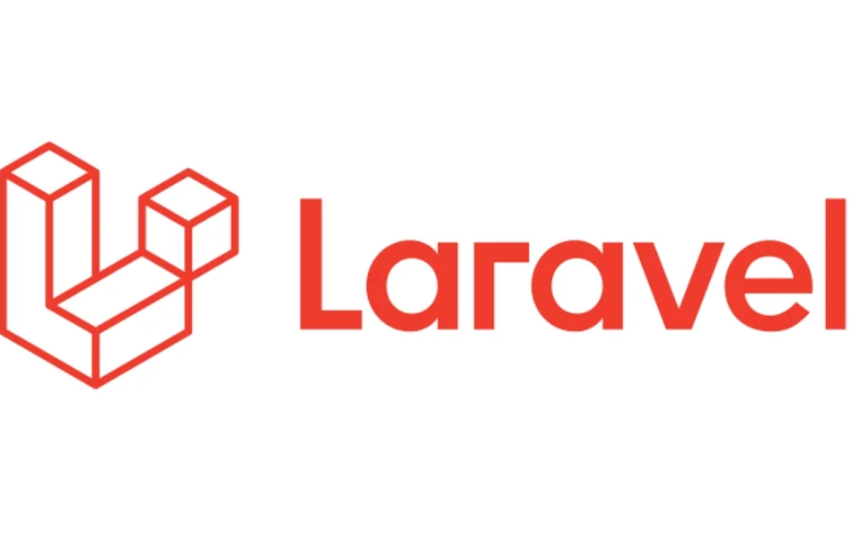
LARAVEL FINAL PROJECT
KIU Career Hub
A practical career-office platform for vacancies, student profiles, applications, file uploads, protected management pages, and JSON API access.
Elene Molashvili
Subject: Laravel
Professor: Lasha Iashvili
Built by continuing and scaling the midterm project into a final backend system.
Notes:
Hello, today I am presenting my final project for the Laravel subject. My name is Elene Molashvili. The project is called KIU Career Hub. It is a Laravel-based platform for managing university career opportunities, student profiles, applications, uploaded resumes, internal tasks, and API access. I continued my midterm project and developed it into a stronger final backend application.

Slide 2
Product vision: one place for KIU career workflow
The idea is not only to submit a Laravel task — it is to solve a real university process.
Before
After
Vacancies can be scattered across messages
Student CVs and skills are hard to compare
Application status is not always visible
Follow-up tasks can be forgotten
Vacancies are created and updated in one system
Student profiles store skills, links, and photo
Applications connect students to vacancies
Admin can manage status, tasks, and data
Product promise: make the career process visible, searchable, and manageable from one Laravel application.
Laravel Final Project · KIU Career Hub
02
Notes:
Here I explain the idea as a product. Before, vacancies, student information, CVs, and follow-up tasks can be spread across different places. The project centralizes this workflow. Staff can manage vacancies, students, applications, statuses, and tasks from one system.

Slide 3
Core workflow: from vacancy to decision
The application follows the natural flow of a university career platform.
1
2
3
4
Vacancy created
Student selected
Application sent
Status reviewed
Admin posts internship/job details
Profile includes faculty, skills, links, photo
Cover letter and resume connect the student to the vacancy
Pending, reviewed, accepted, or rejected
The main model connection is the Application: it belongs to one Student and one Vacancy, but it also stores extra career data like status, cover letter, and uploaded resume.
Laravel Final Project · KIU Career Hub
03
Notes:
This is the main scenario I can demonstrate live. Admin creates a vacancy, student profile exists, an application is created for that vacancy, and staff can later update the application status. The application table is the center of the workflow.

Slide 4
Users and permissions
The system is designed around controlled access, not open editing.
Guest
Authenticated user
Admin
Can view the public entry point and use register/login pages.
Can access the dashboard and main management pages after login.
Can create, edit, delete, and toggle protected resources such as vacancies and tasks.
In code, this is handled by route middleware: guest routes for login/register, auth routes for protected pages, and admin middleware for high-control actions.
Laravel Final Project · KIU Career Hub
04
Notes:
I explain the access control. Guest users can only register or log in. Authenticated users can access the protected pages. Admin users have more privileges, for example creating, editing, deleting, and toggling status. This demonstrates middleware and route protection.

Slide 5
From midterm base to final Laravel system
I did not restart the work — I expanded the midterm into a complete backend project.
Midterm foundation
Final backend upgrade
Vacancy pages
Student pages
Tasks
Dashboard
Basic Blade UI
Authentication + roles
Admin middleware
FormRequest validation
File uploads
Many-to-many relation
API resources
scaled
The final version focuses on the Laravel requirements that prove real backend understanding.
Laravel Final Project · KIU Career Hub
05
Notes:
This slide helps the professor understand continuity. I started with the midterm core and then added final-level features: authentication, roles, admin middleware, file uploads, API resources, many-to-many relationships, and better validation.

Slide 6
System architecture: Laravel layers
The project is organized using Laravel’s standard backend structure.
Blade Views
resources/views
Routes
routes/web.php + routes/api.php
Controllers
app/Http/Controllers
Requests + Middleware
validation + access control
Models + Eloquent
app/Models
Database + Storage
migrations, seeders, public disk
This separation keeps page design, request logic, validation, data models, and storage responsibilities clean.
Laravel Final Project · KIU Career Hub
06
Notes:
Here I show the architecture. Blade is the view layer. Routes receive the request. Controllers run the main logic. FormRequests validate input. Middleware protects access. Models use Eloquent to work with the database. Storage is used for uploaded files.

Slide 7
MVC request lifecycle: create vacancy example
A single form submission shows how Laravel pieces work together.
Blade form
Route
Middleware
Controller
FormRequest
Model
create.blade.php
POST /vacancies
auth + admin
VacancyController@store
VacancyRequest
Vacancy::create
The code path in simple form
Route::post('/vacancies', [VacancyController::class, 'store'])
->name('vacancies.store');
public function store(VacancyRequest $request) {
Vacancy::create($request->validated());
}
Laravel Final Project · KIU Career Hub
07
Notes:
This is a safe technical explanation. I can say: when an admin submits the create vacancy form, the route catches the POST request. The auth and admin middleware protect the route. The controller receives the request, FormRequest validates it, and the Vacancy model saves it through Eloquent.

Slide 8
Database model: relationships that drive the app
The data model represents the career-office workflow.
BRIDGE TABLE
applications
students
vacancies
1 → many
student_id, vacancy_id, cover_letter, resume_path, status
many ← 1
profile, email, faculty, skills, links, photo_path
title, company, type, deadline, status
users
tasks
name, email, password, role
title, due date, status
Many-to-many is achieved through applications: many students can apply to many vacancies.
Laravel Final Project · KIU Career Hub
08
Notes:
This is where I explain relationships. A student has many applications; a vacancy has many applications. Each application belongs to one student and one vacancy. Through the applications table, students and vacancies also become many-to-many.

Slide 9
Relationship code: how Eloquent understands the database
The models make database connections readable and reusable.
Student model
Vacancy model
// Student.php
public function applications() {
return $this->hasMany(Application::class);
}
public function vacancies() {
return $this->belongsToMany(Vacancy::class, 'applications')
->withPivot('cover_letter', 'status', 'resume_path')
->withTimestamps();
}
// Vacancy.php
public function applications() {
return $this->hasMany(Application::class);
}
public function students() {
return $this->belongsToMany(Student::class, 'applications')
->withPivot('cover_letter', 'status', 'resume_path')
->withTimestamps();
}
This code lets the controller load related students, vacancies, applications, and pivot data without writing manual SQL joins.
Laravel Final Project · KIU Career Hub
09
Notes:
Here I do not need to explain every PHP symbol. The professional explanation is: Eloquent relationships let me access related records through models. hasMany handles direct applications. belongsToMany uses the applications table as a pivot and also keeps extra fields such as cover letter, status, and resume path.

Slide 10
CRUD and validation: controlled data entry
Forms are protected, validated, and connected to controllers.
Create
new vacancy, student, task, application
Validation + form protection
// ApplicationRequest.php
'resume' => ['nullable', 'file', 'mimes:pdf,doc,docx', 'max:4096'],
'status' => ['required', Rule::in(['pending','reviewed','accepted','rejected'])],
// Blade forms use @csrf and @method('PUT'/'DELETE')
Read
Delete
index and show pages display database records
protected delete actions
Update
edit forms and status changes
FormRequest classes keep validation separate from controller logic, so controllers stay cleaner.
Laravel Final Project · KIU Career Hub
10
Notes:
This slide explains CRUD and validation together. CRUD means Create, Read, Update, Delete. The project applies CRUD to vacancies, students, tasks, and applications. Every form has CSRF protection, and important data is validated before saving.

Slide 11
File uploads and storage
Student photos and application resumes are handled through Laravel storage.
Form
Request validation
Storage
Database
multipart/form-data
image or document rules
public disk path
path saved with record
Storage path is saved, not the file itself
if ($request->hasFile('photo')) {
$validated['photo_path'] = $request->file('photo')
->store('students/photos', 'public');
}
if ($request->hasFile('resume')) {
$validated['resume_path'] = $request->file('resume')
->store('applications/resumes', 'public');
}
Laravel Final Project · KIU Career Hub
11
Notes:
For file uploads, the form must use multipart/form-data. The request validates the file type and size. Laravel stores the file in storage. The database stores the path. This is better than storing the entire file inside the database.

Slide 12
API layer: same data, JSON response
The backend can serve Blade pages and structured API data.
routes/api.php + API resources
API routes
Route::prefix('v1')->group(function () {
Route::apiResource('vacancies', ApiVacancyController::class);
Route::apiResource('students', ApiStudentController::class);
Route::get('applications', [ApiApplicationController::class, 'index']);
});
return VacancyResource::collection($vacancies);
/api/v1/vacancies
/api/v1/students
/api/v1/applications
These routes are handled by API controllers and return JSON instead of a Blade page.
API Resources control the response shape, so external clients receive clean JSON data.
Laravel Final Project · KIU Career Hub
12
Notes:
Here I explain that the application has two outputs. For normal users it returns Blade pages. For external systems or frontend clients it can return JSON through API routes. API resources control what fields are exposed.

Slide 13
Live demonstration scenario
I will show the project as a product flow, not as random pages.
1
Login
Admin enters protected area
2
Vacancy
Create or open a career opportunity
3
Student
Open a profile with skills and photo
4
Application
Connect student to vacancy and review status
5
API
Open JSON endpoint for the same data
The demo follows the real story of the application: a career office manages an opportunity from creation to review.
Laravel Final Project · KIU Career Hub
13
Notes:
This is not a cheat sheet; it is the live demo plan. I can say I will demonstrate it through a product scenario: log in as admin, open dashboard, create or view a vacancy, open a student profile, show an application and status, then open an API endpoint.

Slide 14
Conclusion: Laravel concepts turned into a working system
KIU Career Hub combines product value with the technical Laravel requirements.
Product value
Laravel proof
Centralized career workflow
Clear student–vacancy matching
Application status tracking
Files and profiles in one place
MVC structure
Eloquent relationships
CRUD with validation
Auth, middleware, uploads, API
Thank you
Elene Molashvili · Subject: Laravel · Professor: Lasha Iashvili
Laravel Final Project · KIU Career Hub
14
Notes:
Closing: To conclude, KIU Career Hub is a complete Laravel final project that combines a real university career-office idea with technical Laravel requirements. It uses MVC, Eloquent, relationships, CRUD, Blade, validation, authentication, middleware, file uploads, and API endpoints. Thank you.

